Slide 1
Takaful
An emerging niche market

Slide 2
Outline of Presentation
Objections to Conventional Insurance
Introduction to Takaful
Difference b/w Conventional Insurance & Takaful
Takaful Through Time
Takaful Models
Takaful Types
ReTakaful
Challenges to Takaful

Slide 3
Objections to Conventional Insurance

Slide 4
Insurance Defined
Definition of an Insurance Contract
“An agreement whereby one party, the insurer, in return for a consideration, the premium, undertakes to pay to the other party, the insured, a sum of money or its equivalent in kind on the happening of a specified event, which is contrary to the insured’s financial interest”
Subject-matter of an Insurance Contract
“… what is it that is insured in a fire policy? Not the bricks and materials used in building the house, but the financial interest (i.e. money) of the insured in the subject-matter of insurance …” (Lord Justice Brett in Castellian v. Preston – 1883)

Slide 5
Objections to Conventional Insurance
Scholars view the insurance contract as an exchange contract – money is being exchanged for money over time.
This brings about the problem of gharrar (which leads to maisir) and in investments aspect, riba.
Elements of:
Uncertainty – Gharrar
Gambling – Maisir
Interest – Riba
UW + Investment Profit belongs to the Company
Note that the Scholars do not object to insurance per se but only to certain weaknesses in the insurance contract.

Slide 6
Introduction to Takaful

Slide 7
Meaning of Takaful
Takaful comes from the Arabic root-word ‘kafala’ — guarantee.
Takaful means mutual protection and joint guarantee.
Operationally, takaful refers to participants mutually contributing to a common fund with the purpose of having mutual indemnity in the case of peril or loss.

Slide 8
Reference — Al Quran:
“Help (ta’awan) one another in furthering virtue (birr) and Allah consciousness (taqwa) and do not help one another in furthering evil and enmity”. Al Maidah: verse 2 (5:2).
Takaful is a form of mutual help (ta’awun) in furthering good/virtue by helping others who are in need / in hardship .

Slide 9
Reference – Hadith:
“tie the camel first, then submit (tawakkal) to the will of Allah”
The hadith implied a strategy to mitigate/reduce risk.
Takaful provides a strategy of risk mitigation/reduction by virtue of collective risk taking that distributes risks and losses to a large number of participants. This mitigates the otherwise very damaging losses, if borne individually.

Slide 10
Fiqh Academy Resolution 1985
Islamic Fiqh (science of Shariah) Academy, emanating from the Organization of Islamic Conference, meeting in its Second Session in Jeddah, KSA, from 10 to 16 Rabi-ul- Thani, 1405 A.H. (Dec 1985) issued a Resolution which in summary stated the following:
The commercial Insurance contract… is prohibited (Haraam) according to the Shariah.
The alternative Takaful contract which conforms to the principles of Islamic dealings is Halaal, being the contract of cooperative insurance, which is founded on the basis of charitable donation and Shariah compliant dealings.

Slide 11
Basic Elements of Takaful
Mutuality and cooperation.
Takaful contract pertains to Tabarru’at as against mu’awadat in case of conventional insurance.
Payments made with the intention of Tabarru (contribution)
Eliminates the elements of Gharrar, Maisir and Riba.
Wakalah/Modarabah basis of operations.
Joint Guarantee / Indemnity amongst participants – shared responsibility.
Constitution of separate “Participants’ Takaful Fund”.
Constitution of “Shariah Supervisory Board.”
Investments as per Shariah.

Slide 12
Main drivers of Takaful
Piety (individual purification)
Brotherhood (mutual assistance)
Charity (Tabarru or contribution)
Mutual Guarantee
Community well-being as opposed to profit maximization.

Slide 13
Comparing Takaful to Conventional Insurance
Issue | Conventional Insurance | Takaful
Organization Principle | Profit for shareholders | Mutual for participants
Basis | Risk Transfer | Co-operative risk sharing
Value Proposition | Profits maximization | Affordability and spiritual satisfaction
Laws | Secular/Regulations | Sharia plus regulations
Ownership | Shareholders | Participants
Management status | Company Management | Operator
Form of Contract | Contract of Sale | Cooperative, Islamic contracts of Wakala or Mudarbah with Tabar’ru (contributions)
Investments | Interest based | Sharia compliant, Riba-free
Surplus | Shareholders’ account | Participants’ account

Slide 14
Takaful Through Time

Slide 15
Takaful through Time
Origins in the First Constitution of Madina.
It evolved and continued in one form or the other throughout the Abbaside period and even later during the Ottoman empire.
Serious efforts were made in modern times, in 1970s to come up with an Islamic alternative to the conventional insurance.
The first Takaful company was set up in Sudan in 1979, almost simultaneously followed by another one set up in Bahrain.

Slide 16
Takaful through Time… (Cont’d.)
There are now 200+ Takaful companies round the globe.
The total global insurance premium for 2017 was USD 4891 Billion; of this, Takaful contribution accounts for 5% (i.e. USD 20 Billion). This is expected to increase to USD 40 Billion by 2021.
Poor Insurance penetration in the Muslim countries (<1% of GDP).
Average growth rate higher than conventional insurance companies (around 25%).
Non–Muslims increasingly opting for Takaful products for commercial benefits.

Slide 17
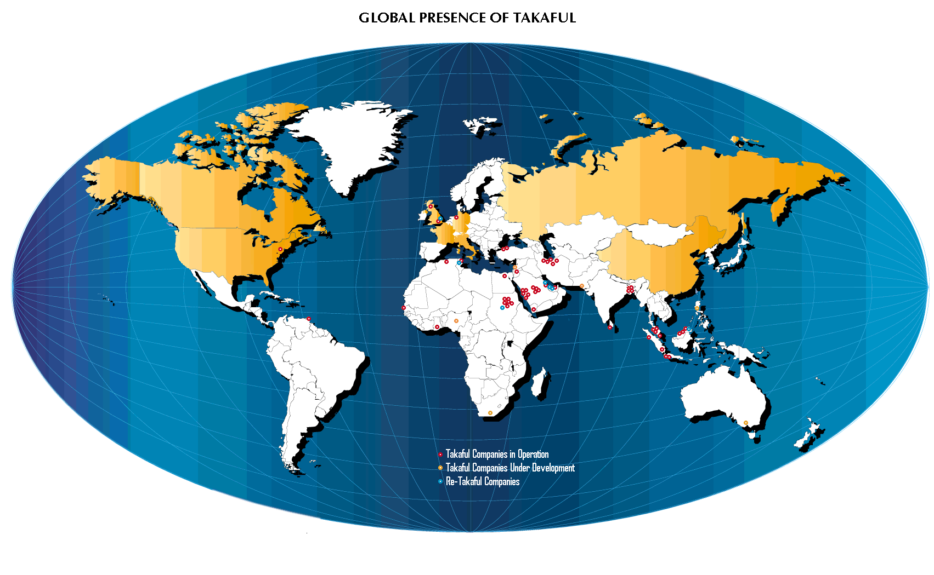

Slide 18
Models – The beauty of Islam lies in its
plurality … !

Slide 19
ISLAM
AQIDAH
Faith & Belief
SHARIAH
Practices & Activities
AKHLAQ
Moralities & Ethics
IBADAH
Man-to-God Worship
MUAMALAT
Man-to-Man Activities
Political
Activities
Economic
Activities
Social
Activities
Risk Management
Takaful

Slide 20
ReTakaful
Currently few ReTakaful companies worldwide offering a relatively small capacity:
Sudan (1979) National Reinsurance.
Sudan (1983) Sheikhan Takaful Company.
Tunis Retakaful
Lloyds of London has a ReTakaful Syndicate.
SwissRe has formed a separate ReTakaful Pool
MunichRe ReTakaful Pool
Hannover Retakaful
Labuan Retakaful
Saudi Re
RGA Global Reinsurance Company Ltd
MNRB Retakaful Berhad
Malaysian Retakaful
Kenya Retakaful
Africa Retakaful
Zep Re Retakaful
Ethio Retakaful

Slide 21
TAKAFUL - TARGET MARKET
People who do not insure due to religious reasons.
People who insure and are insensitive to religious reasons.
People who currently do not insure at all.

Slide 22
Challenges to Takaful
Skepticism.
Lack of uniformity in Shariah decisions.
Regulatory issues.
Capacity constraints due to inadequate ReTakaful.
Limited Investment avenues.
H.R. issues.

Slide 23
Thank you for your attention

